Slide 1
19CSE202 Database Mangement Systems E-R Model

Slide 2
Database Design
The steps are - User interaction, requirement gathering, selection a data model, construct the conceptual schema, refine, implement.
Two major pit falls
(1) Redundancy
(2) Incompleteness

Slide 3
Two major pit falls
(1) Redundancy
Eg.
faculty (id, name, salary, dept_name, building, budget)
instead of
instructor (id, name, salary, dept_name)
department (dept_name, building, budget)
(2) Incompleteness
Eg. If we have only the section table instead of course and section.

Slide 4
E-R (Entity – Relationship) Model
Basic Structure
Attribute Types
Constraints
Weak Entity Sets
E-R Diagram for University Enterprise

Slide 5
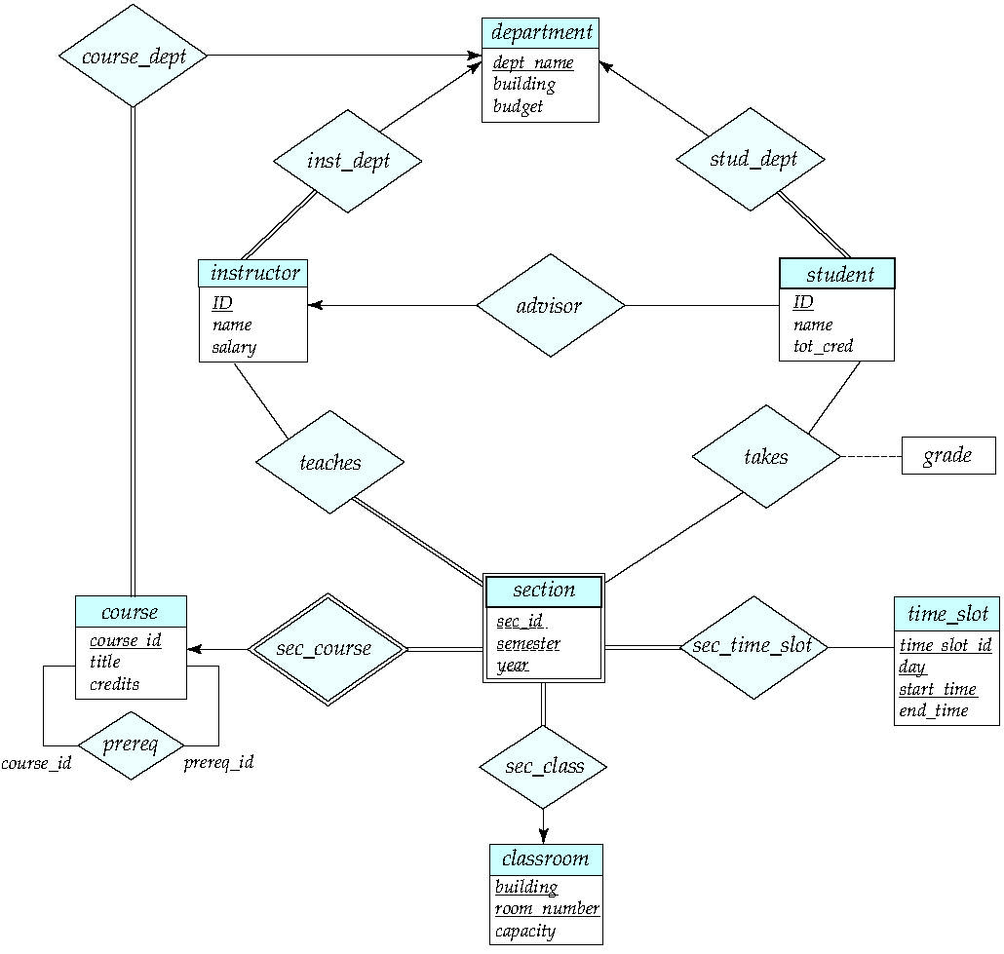

Slide 6
E-R (Entity – Relationship) Model
Basic Structure
Attribute Types
Constraints
Weak Entity Sets
E-R Diagram for University Enterprise

Slide 7
Basic structure
An Entity Relationship diagram is a visual representation of different data using conventions that describe how these data are related to each other.
An entity can be a real-world object that can be easily identifiable.
Example: specific person, company, event, plant.
An entity set is a set of entities of the same type that share the same properties.
Example: set of all persons, companies, trees, holidays.

Slide 8
Basic structure
An entity is represented by a set of attributes; i.e., descriptive properties possessed by all members of an entity set.
Example:
instructor = (ID, name, street, city, salary ) course= (course_id, title, credits)
A subset of the attributes form a primary key of the entity set; which aids in uniquely identifying each member of the set.
Example: ID of students.

Slide 9
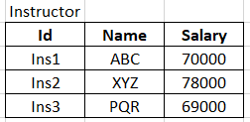
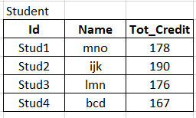
Basic structure
Entities can be represented graphically as follows:
Rectangles represent entity sets.
Attributes are listed inside entity rectangle.
Underline indicates primary key attributes.
instructor
student
ID
name
salary
ID
name
tot_cred

Slide 10
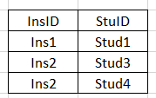
Basic structure
Relationship set is an association among several entity sets.
Diamond represents relationship set.
Eg. Relationship and Relationship Set.
Ins1 is an advisor of Stud2
Ins2 is an advisor of Stud3 and Stud4
instructor
student
ID
name
salary
advisor
ID
name
tot_cred

Slide 11
If (E1, E2, …, En) are the entity sets then a relationship set (R) is a subset {(e1, e2, …., en) / e1 ∈ E1, e2 ∈ E2….en ∈ En}
Eg (Instructor, student) are the entity sets
Advisor{(InsId, StudId), InsId ∈ Instructor, StudId ∈ Student)
Other examples
Instructor teaches courses
Students register courses
Participation .. E1, E2, … , En are said to be participating in R.
Role .. The function what an entity play in a relationship. Eg. Advising

Slide 12
Recursive Relationship
course
course_id
prereq
course_id
title
credits
prereq_id

Slide 13
Descriptive attributes
Relationship sets with attributes can be represented as:
date
instructor
student
ID
name
salary
advisor
ID
name
tot_cred
Student --- Takes --- Section.
|
Grade

Slide 14
Possible to have more than one relationship involving the same entity sets.
instructor – class_advisor – students
instructor – faculty_advisor – students
Binary relationship sets.
Possible to have more than two entity sets also
Instructor - - Proj_Guide - - Project
|
Student

Slide 15
E-R (Entity – Relationship) Model
Basic Structure
Attribute Types
Constraints
Weak Entity Sets
E-R Diagram for University Enterprise

Slide 16
Attributes
Attribute types:
Simple and composite attributes.
Simple – can not divide further, composite – can be
Eg. Simple : Age, CGPA
Composite:
Name – first name, middle name, last name
Address – doorno, street, city.

Slide 17
Single-valued and multivalued attributes
Single-valued – only one value. (Eg. Age)
Multivalued – multiple values. (Eg. phone_numbers)
Derived attributes
Can be computed from other attributes
Example: age, given date_of_birth
Here date_of_birth is denoted as stored or base attribute.

Slide 18
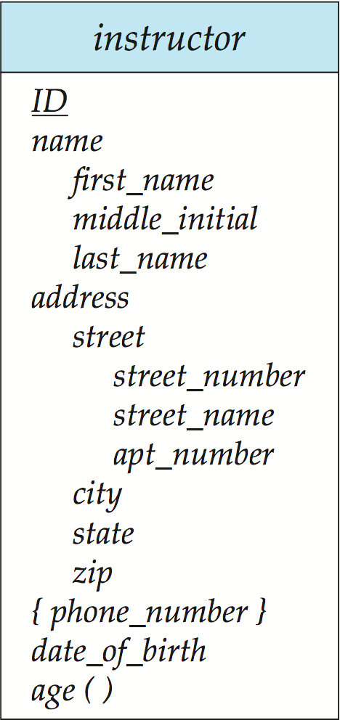
Complex Attributes - Representation
Here, in this entity set, name ,address and street are composite attributes. phone _number is a multi-valued attribute hence represented as {phone _number } and age is derived attribute hence represented as age().

Slide 19
E-R (Entity – Relationship) Model
Basic Structure
Attribute Types
Constraints
Weak Entity Sets
E-R Diagram for University Enterprise

Slide 20
Constraints
Mapping Cardinalities
Participation Constraints
Keys

Slide 21
Mapping Cardinalities
We express cardinality constraints by drawing either a directed line (→) signifying “one” or an undirected line (—) signifying “many” , between the relationship set and the entity set.
For a binary relationship set the mapping cardinality must be one of the following types:
One to one
One to many
Many to one
Many to many

Slide 22
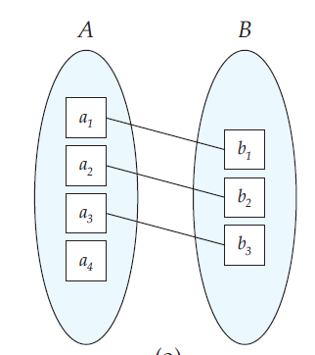
Mapping Cardinalities
One-to-one relationship:
An example of one-to-one relationship between an instructor and a student :
In the above diagram the directed lines to instructor and student indicates that an instructor may advise at most one student, and a student may have at most one advisor.
instructor
student
ID
name
salary
advisor
ID
name
tot_cred

Slide 23
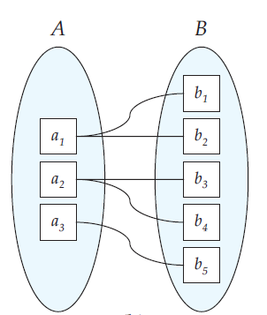
Mapping Cardinalities
One-to-many relationship:
An example of one-to-many relationship between an instructor and a student :
In the above diagram there is a directed line from relationship set advisor to the entity set instructor, and an undirected line to the entity set student.
This indicates that an instructor may advise many students, but a student may have at most one advisor.
instructor
student
ID
name
salary
advisor
ID
name
tot_cred

Slide 24
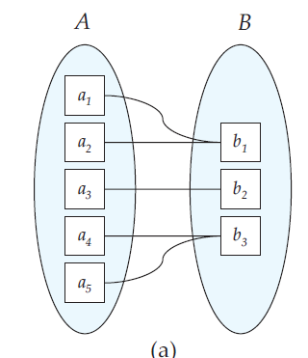
Mapping Cardinalities
Many-to-One relationship:
An example of many-to-one relationship between an instructor and a student :
In the above diagram there is an undirected line from the relationship set advisor to the entity set instructor and a directed line to the entity set student.
This indicates that an instructor may advise at most one student, but a student may have many advisors.
instructor
student
ID
name
salary
advisor
ID
name
tot_cred

Slide 25
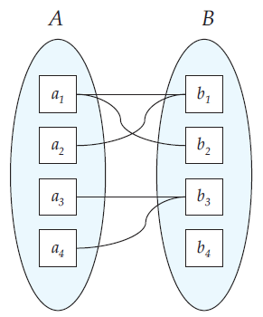
Mapping Cardinalities
Many-to-Many relationship:
An example of many-to-many relationship between an instructor and a student :
In the above diagram there are undirected lines from the relationship set advisor to both entity sets instructor and student.
This indicates that an instructor may advise many students, and a student may have many advisors.
instructor
student
ID
name
salary
advisor
ID
name
tot_cred

Slide 26
Participation Constraints
Total and Partial Participation:
Total participation is indicated by double line where, every entity in the entity set participates in at least one relationship in the relationship set.
Partial participation is indicated by a single line where, some entities may not participate in any relationship in the relationship set.
University may require every student to have at least one advisor, In contrast, an instructor need not advise any students.
instructor
student
ID
name
salary
advisor
ID
name
tot_cred

Slide 27
Keys
For the relationship set R (E1, E2, …, En),
If R has no descriptive attributes then
The attribute set of (R)= {Primary_key (E1) U Primary_key (E2) U … U Primary_Key (En)).
Else
The attribute set of (R)= {(Primary_key (E1) U Primary_key (E2) U … U Primary_Key (En))U{a1, a2,…,a3}).
where {a1, a2,…,a3} are the descriptive attribute of R.
In the both the cases
The primary key(R) = Primary_key (E1) U Primary_key (E2) U … U Primary_Key (En)

Slide 28
Keys
The key can be decided based on the mapping cardinality also
R: Instructor - Advisor - Student
(date)
If many-to-many : PK(Advisor) = PK(Instructor) U PK(Student).
If one-to-many : PK(Advisor)=PK(Student)
If many-to-one : PK(Advisor)=PK(Instructor)
If one-to-one: PK(Advisor) = either PK(Student) or PK(instructor)

Slide 29
Notation for Expressing mapping cardinalities
A line may have an associated minimum and maximum cardinality, shown in the form l..h, where l is the minimum and h the maximum cardinality
A minimum value of 1 indicates total participation.
A maximum value of 1 indicates that the entity participates in at most one relationship
A maximum value of * indicates no limit.
Instructor can advise 0 or more students. A student must have 1 advisor; cannot have multiple advisors
instructor
student
ID
name
salary
0..*
advisor
1..1
ID
name
tot_cred

Slide 30
Roles
Roles in E-R diagrams by labeling the lines that connect diamonds to rectangles.
The labels “course_id” and “prereq_id” are called roles.
course
course_id
prereq
course_id
title
credits
prereq_id

Slide 31
E-R (Entity – Relationship) Model
Basic Structure
Attribute Types
Constraints
Weak Entity Sets
E-R Diagram for University Enterprise

Slide 32
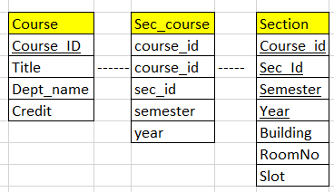
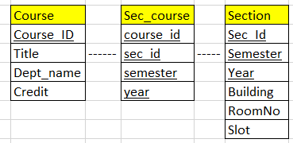
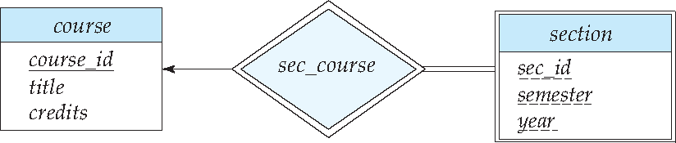
Weak and Strong Entity Sets
Now the Section does’t have enough attribute to create the primary key – hence it is the weak entity set.
The entity set which has the primary key is called as the strong entity set.
(or owner entity set or identifying entity set)
The weak entity set is existent dependent on identifying entity set.
The identifying entity set owns the weak entity set.
This relationship is called as identifying relationship
So we need to denote that specially in E-R diagram

Slide 33
Weak and Strong Entity sets
In E-R diagrams, a weak entity set is depicted via a double rectangle.
We underline the discriminator of a weak entity set with a dashed line.
(other attributes which are the part of primary key, or partial key)
The relationship set connecting the weak entity set to the identifying strong entity set is depicted by a double diamond.
Primary key for section – (course_id, sec_id, semester, year).
The participation of weak entity set is total.
The cardinality is many-to-one from weak entity set to strong entity set.
The relationship should not have any descriptive attributes.

Slide 34
E-R (Entity – Relationship) Model
Basic Structure
Attribute Types
Constraints
Weak Entity Sets
E-R Diagram for University Enterprise

Slide 36
Coursera course
Relational Modelling in Dia

Slide 37
Thank You
Happy to answer any questions ! ! !
Notes:
Not covering all.

Slide 38
Resources:
Text Book:
Silberschatz A Korth H F and SudharshanS , “Database System Concepts”, 6th Edition, TMH publishing company limited, 2011.
7th edition of text book is released in 2019 https://www.db-book.com/db7/index.html
6th edition Textbook Link https://www.db-book.com/db6/index.html
References:
Hector Garcia-Molina, Jeffrey D Ullman, JennierWidom, ‘Database System ; The complete book”, 2nd Edition, 2011.
Elmasri R and Navathe S B, “Fundamentals of Database Systems”, 5th Edition, Addison Wesley, 2006.
Ramakrishnan R and Gehrke J, “Database Management Systems”, 3rd Edition, TMH, 2003

